Slide 1


Social Buzz Analysis
Accenture Virtual Internship Program

Slide 2


Today's agenda
Project recap
Problem
The Analytics team
Process
Insights
Summary

Slide 3

Social Buzz, a Social Media & Content Creation company. The company needs advisory help to manage its vast, unstructured data generated by over 100,000 daily content posts.
Project deliverables:
Audit of big data practices
IPO recommendations
Analysis of top 5 content categories by popularity
Project Recap

Slide 4


Problems
Over 100,000 post per day
36,500,000 pieces of content per year
But how to capitalize on it when there is so much?
Analyze to find Social Buzz’s
top 5 most popular categories of content

Slide 5



ANDREW FLEMING
Chief Technology Architect
The Analytics team
MARCUS ROMPTON
Senior Principal
QUYEN MAI
Data Analyst

Slide 6
Process
1
Data Understandings
2
Data Cleaning:
3
Data Modelling
4
Data Analysis
5
Uncover Insights

Slide 7

Insights
962
Unique Contents
16
Unique Categories
May
is the month with highest posts

Slide 8
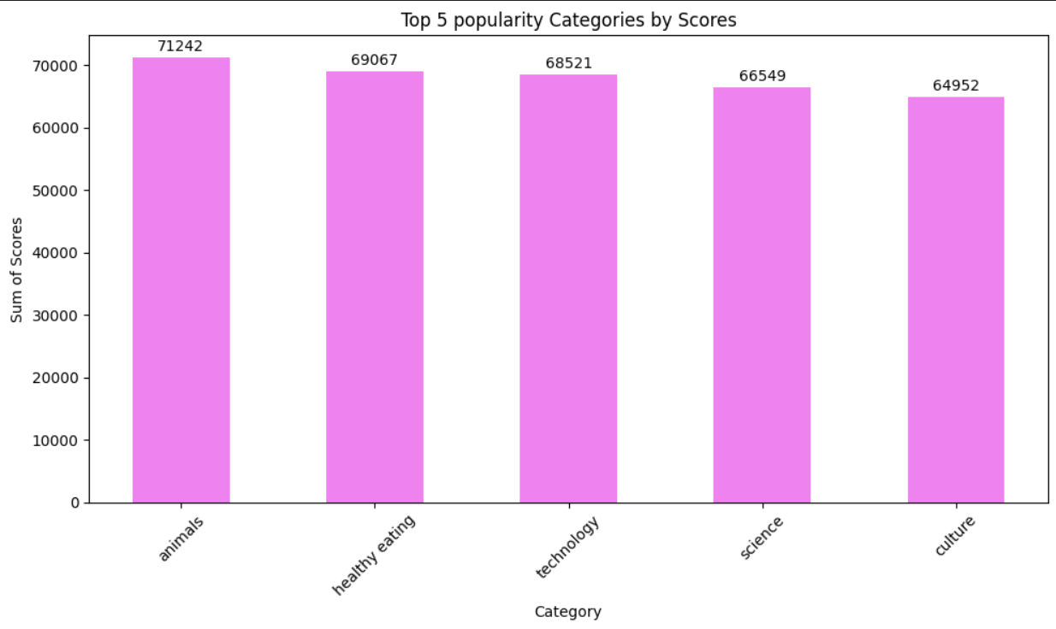

Slide 9
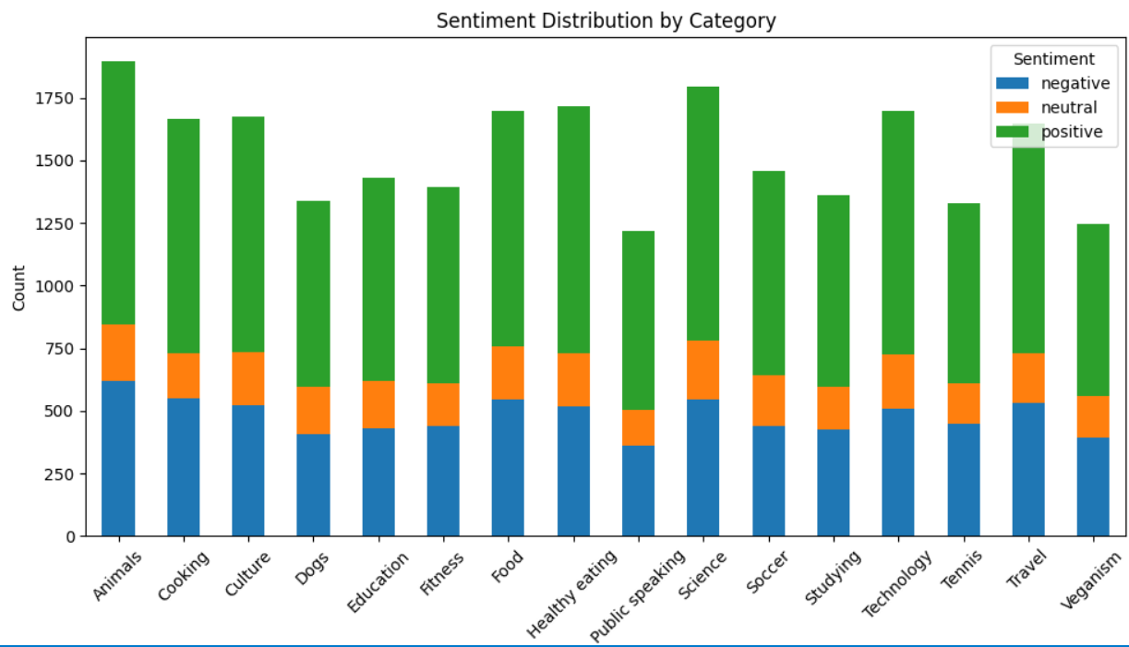

Slide 10

Animals, healthy eating, technology, science, culture are the most popularity categories
Summary
Users tend to give positive reactions across all categories, with only a few exhibiting neutral emotions.

Slide 11

Thank you!
ANY QUESTIONS?

